Slide 1
Web Scraping
For fun and profit

Slide 2
Who am I ?
Khalid Mohamed Elboray
Backend Developer
Perl - Mojolicious
Python - Django
And any thing does the job
@khaildelboray

Slide 3
What is web-scraping ?
Web scraping is the process of automatically mining data
or collecting information from the World Wide Web
Techniques
Human copy-and-paste
Text pattern matching
HTTP programming
HTML parsing
DOM parsing

Slide 4
Human copy-and-paste
The simplest form of web scraping is manually copying and pasting data from a web page into a text file or spreadsheet. Sometimes even the best web-scraping technology cannot replace a human's manual examination and copy-and-paste, and sometimes this may be the only workable solution when the websites for scraping explicitly set up barriers to prevent machine automation.
Pros | Cons
Accurate | Expensive
No barriers | Long Time

Slide 5
Text pattern matching
A simple yet powerful approach to extract information from web pages can be based on the UNIX commands (grep, sort, cut etc.…) or regular expression-matching facilities of programming languages (for instance Perl or Python).

Slide 6

HTTP programming
Static and dynamic web pages can be retrieved by posting HTTP requests to the remote web server using socket programming, user agents provided by various libs in programming languages, Web APIs and REST APIs.
User Agent/ HTTP Libs in Perl and Python
Perl | Python
HTTP::UserAgent | requests
Mojo::UserAgent | aiohttp
Image by author (made using Canva)

Slide 7
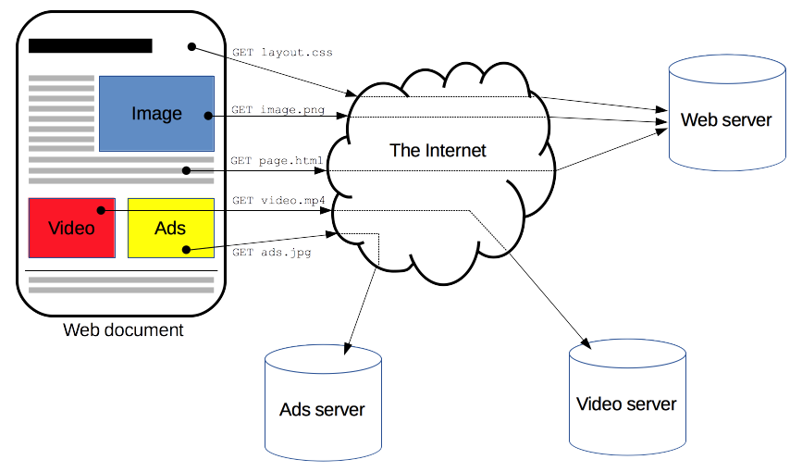
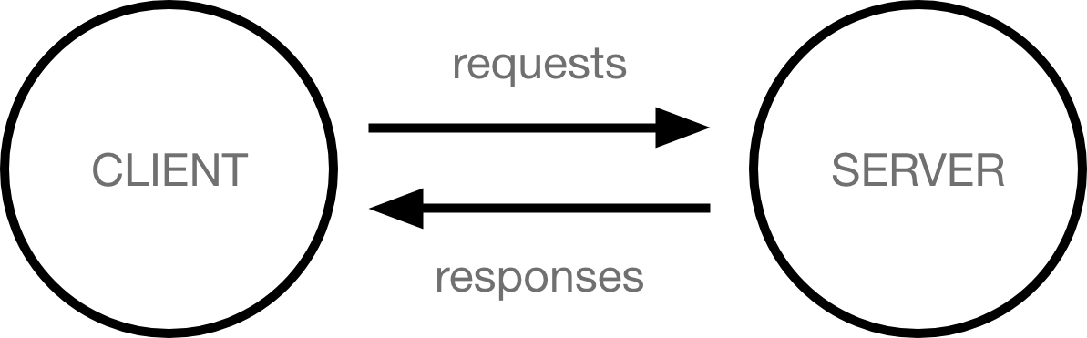

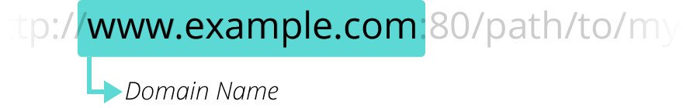
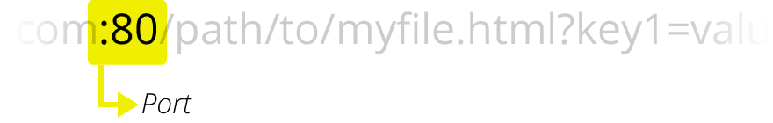
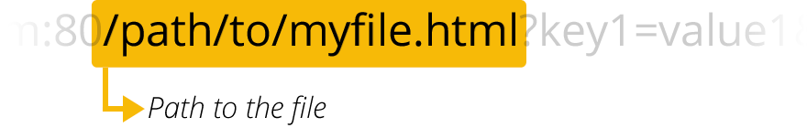
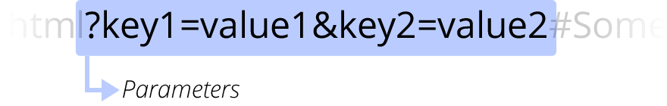
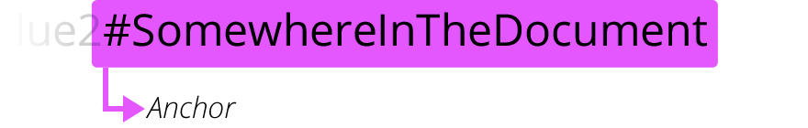
Python Requests
Before we go there, let’s have a look at what a web page is and how to access it
URL format (RFC 2396)
scheme:[//[user:password@]host[:port]][/]path[?query][#frahment]
http://www.example.com:80/path/to/myfile.html?key1=value1&key2=value2#SomewhereInTheDocument

Slide 8
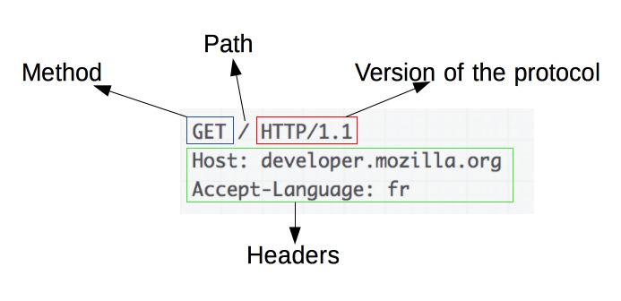
Requests
Requests consists of the following elements:
An HTTP method, usually a verb like GET, POST or a noun like OPTIONS or HEAD that defines the operation the client wants to perform. Typically, a client wants to fetch a resource (using GET) or post the value of an HTML form (using POST), though more operations may be needed in other cases.
The path of the resource to fetch; the URL of the resource stripped from elements that are obvious from the context, for example without the protocol (http://), the domain (here, developer.mozilla.org), or the TCP port (here, 80).
The version of the HTTP protocol.
Optional headers that convey additional information for the servers.
Or a body, for some methods like POST, like those in responses, which contain the resource sent.

Slide 9
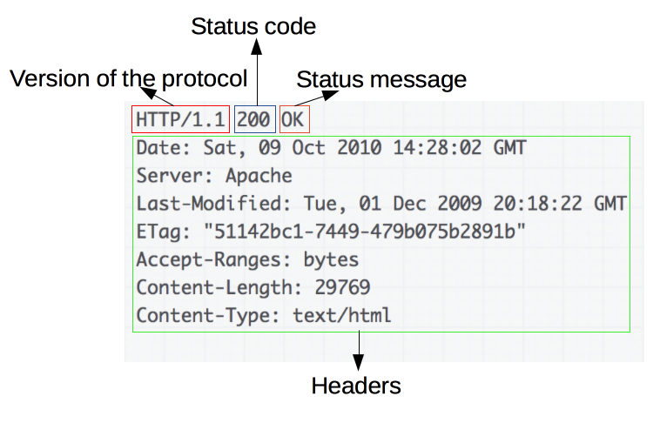
Responses
Responses consist of the following elements:
The version of the HTTP protocol they follow.
A status code, indicating if the request was successful, or not, and why.
A status message, a non-authoritative short description of the status code.
HTTP headers, like those for requests.
Optionally, a body containing the fetched resource.

Slide 10
Packages
Requests
import requests
Request
Method
GET,POST,…
response = requests.get(<str:url>)
response = requests.get(<str:url>,params=<dict>)
response = requests.post(<str:url>,data=<str:body>)
response = requests.post(<str:url>,data=<dict:body>)
Session
session = requests.Session()
response = session.get(<str:url>)
Headers
response = requests.get(<str:url>,headers=<dict>)
Cookies
response = requests.get(<str:url>,cookies=<dict>)

Slide 11
Response
Status Code
response.status_code
Headers
response.headers[<str:name>]
Cookies
response.cookies[<str:name>]
Binary Content
response.content
Text Content
response.text
Json Content
response.json()

Slide 12
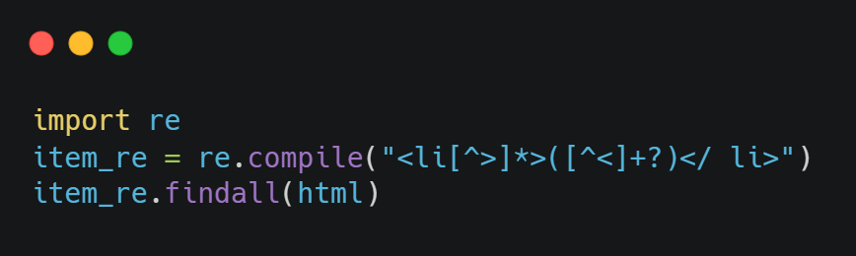
HTML Parsing
Regex ?
DON’T DO THIS !
It works.. But ?
There are 3 problems (at least)
Image by author (made using carbon.now.sh)
Fragile - Easy to break even with slight HTML changes (like newlines, order of attributes etc.)
Hard to maintain – Regex based scrapers are good Only when they’re used in write-only scripts
Improper HTML & encoding handling

Slide 13
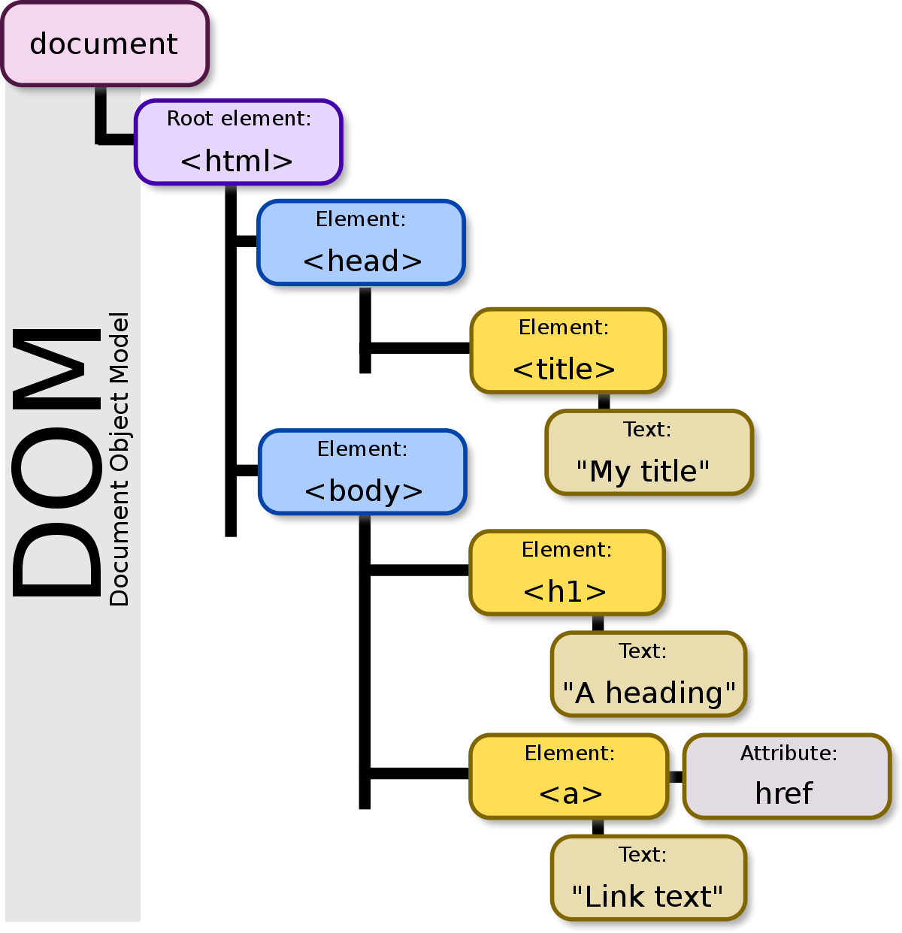
HTML Parsing
Attribute name
Attribute value
<p lang=“en-us”> Element Content </p>
Opening Tag
Closing Tag
Content

